Slide 1

Hover Squad
Ai Assisted Farming Drone
In partnership with
Group 42
Cade Smeller, He Yingrui, Xu Siyi, Leia Dalcomune, Kuilin Shen, Matthew Shamray

Slide 2
Team BIO
Cade: Electrical Engineering, work as a test engineer for L3Harris currently.
Leia: Electrical Engineering, Experience in Automation and Sensor implementation.
Harriet: Electrical Engineering, experience with machine learning and electrical software design
Alex: Electrical Engineering, experience with embedded systems and semiconductor device
Lin: Mechanical Engineering, experience with simulations and modeling
Matthew: Computer Science, experience as a full stack developer, software engineer at Siemens. Experience with generative AI/machine learning driven solutions.

Slide 3
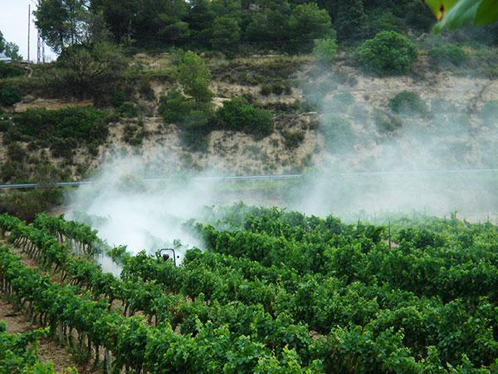
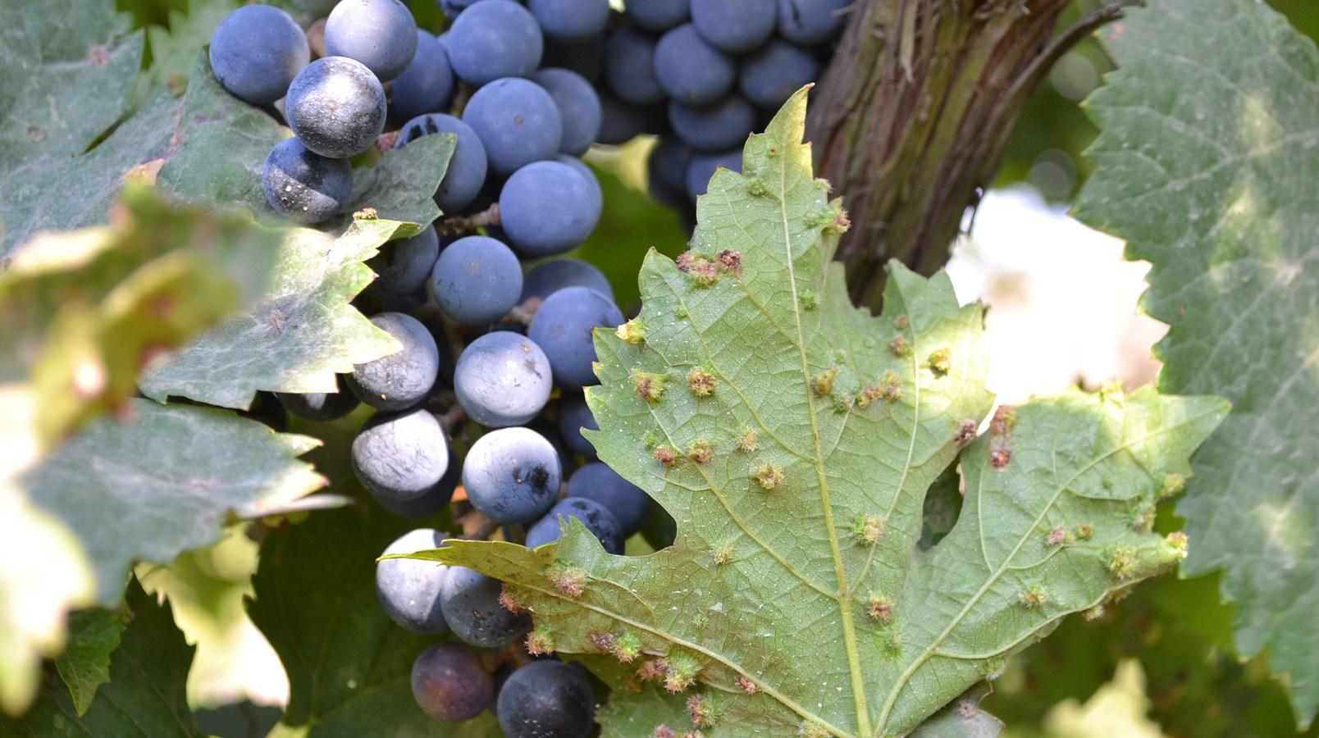
Background
Modern agriculture uses mass spraying of pesticides to prevent disease and control pest populations
Mass spraying is both expensive and harmful to the environment due to agricultural runoff
Agricultural drones provide a path for farmers to monitor crops and apply pest control with targeted methods
Currently these drones and monitoring techniques are inaccessible:
Drones are prohibitively expensive
Drones do not come with a native API, requiring third party programs to interpret data
Current pesticide application is done via mass spraying of all crops
Phylloxera, a common vineyard pest

Slide 4
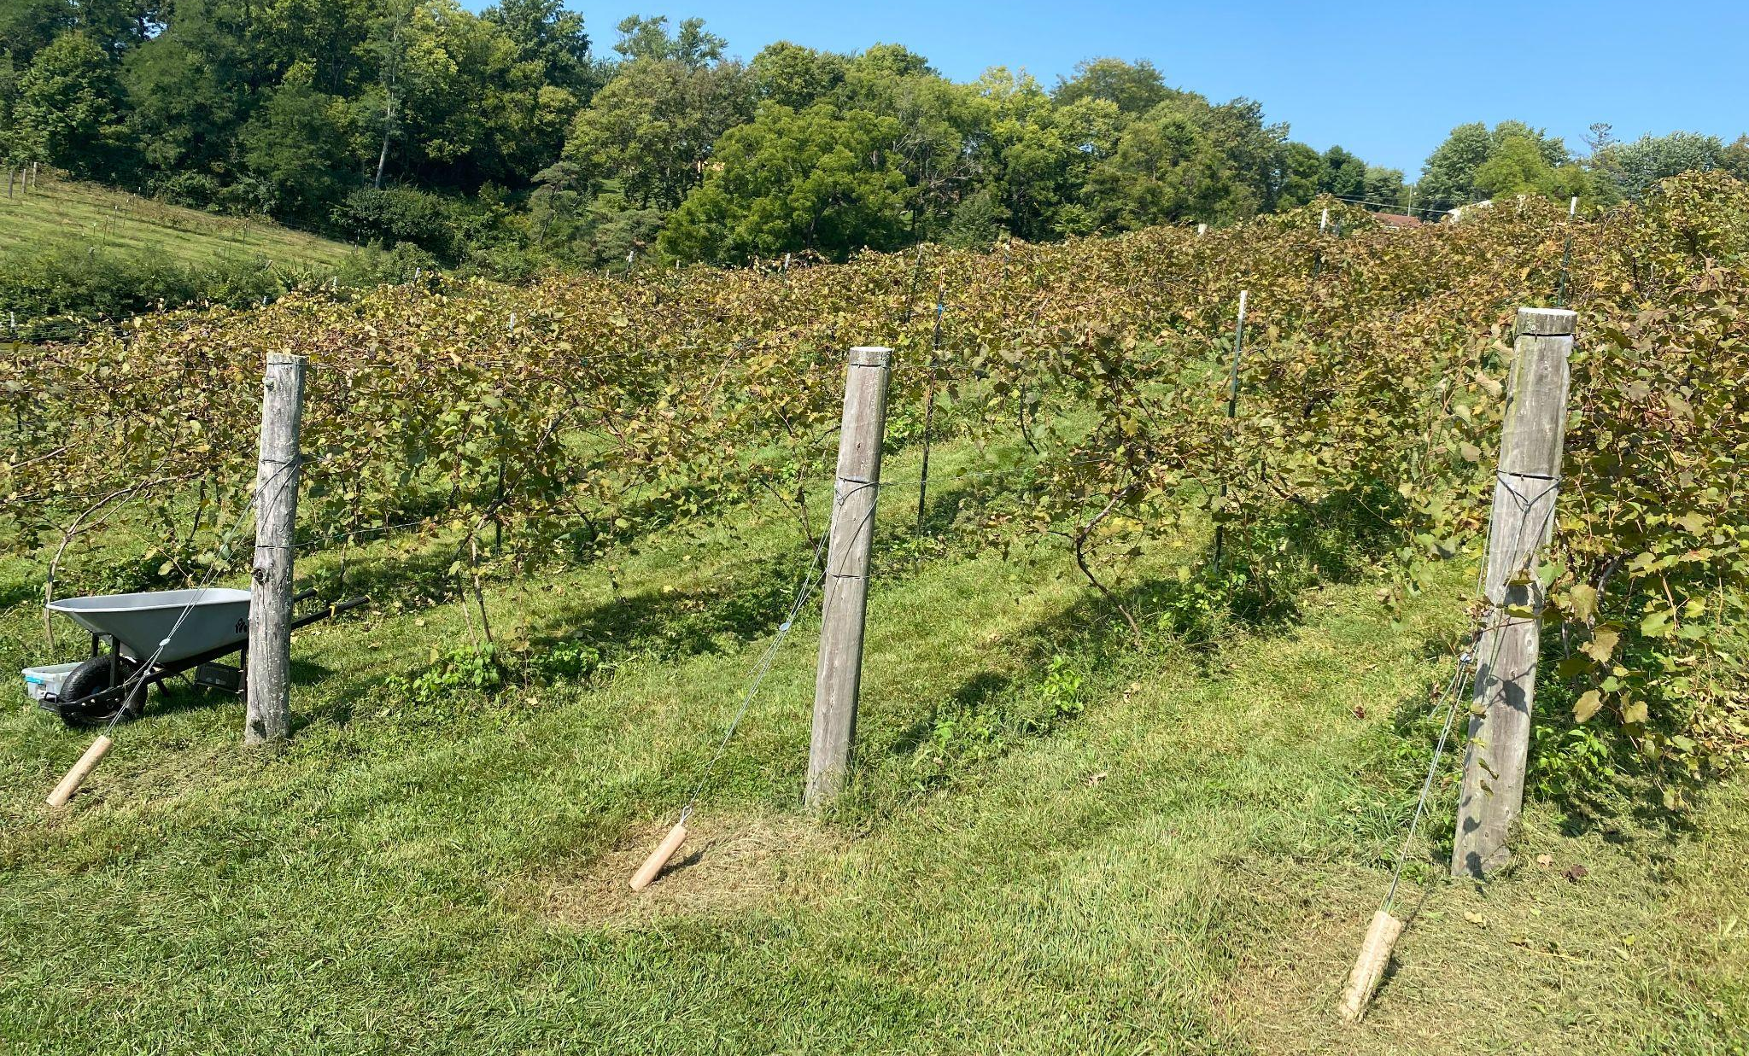
Proposed Solution
Camera assembly that can be mounted to both tractors and drones:
Allows farmers to mount on existing farming equipment
The camera will gather data and our onboard computer will collect and upload the data for processing
An AI model will process and analyze images and videos to detect pests and diseases
A mobile app native to our product will be used to communicate this data directly to the farmer
Testing will be done at a local vineyard in Ohio later in the semester
Photo of vineyard we will be testing at

Slide 5
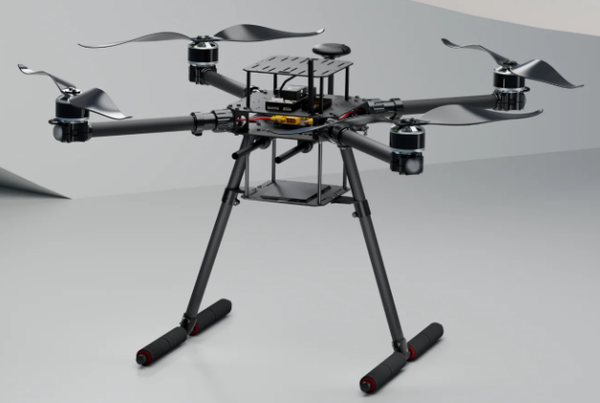
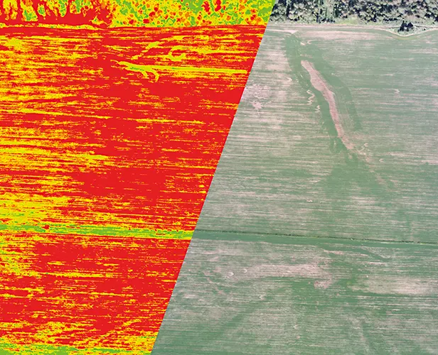
Design Solutions and Choices
Hardware Selection:
Drone Platform:
X650 Development Kit by Holybro
Drone kit offers the power we need to lift our camera assembly at the lowest price
Sensors and Cameras:
Multispectral/Near Infrared Camera
The NIR band is most important for crop scouting
Computing Hardware
Raspberry Pi 5 to process images and video, and upload them to the cloud for AI processing
Chosen for simplicity, ease of standardization, and its computing ability
X650 Development Kit
Example of Multispectral vs Normal Camera

Slide 6
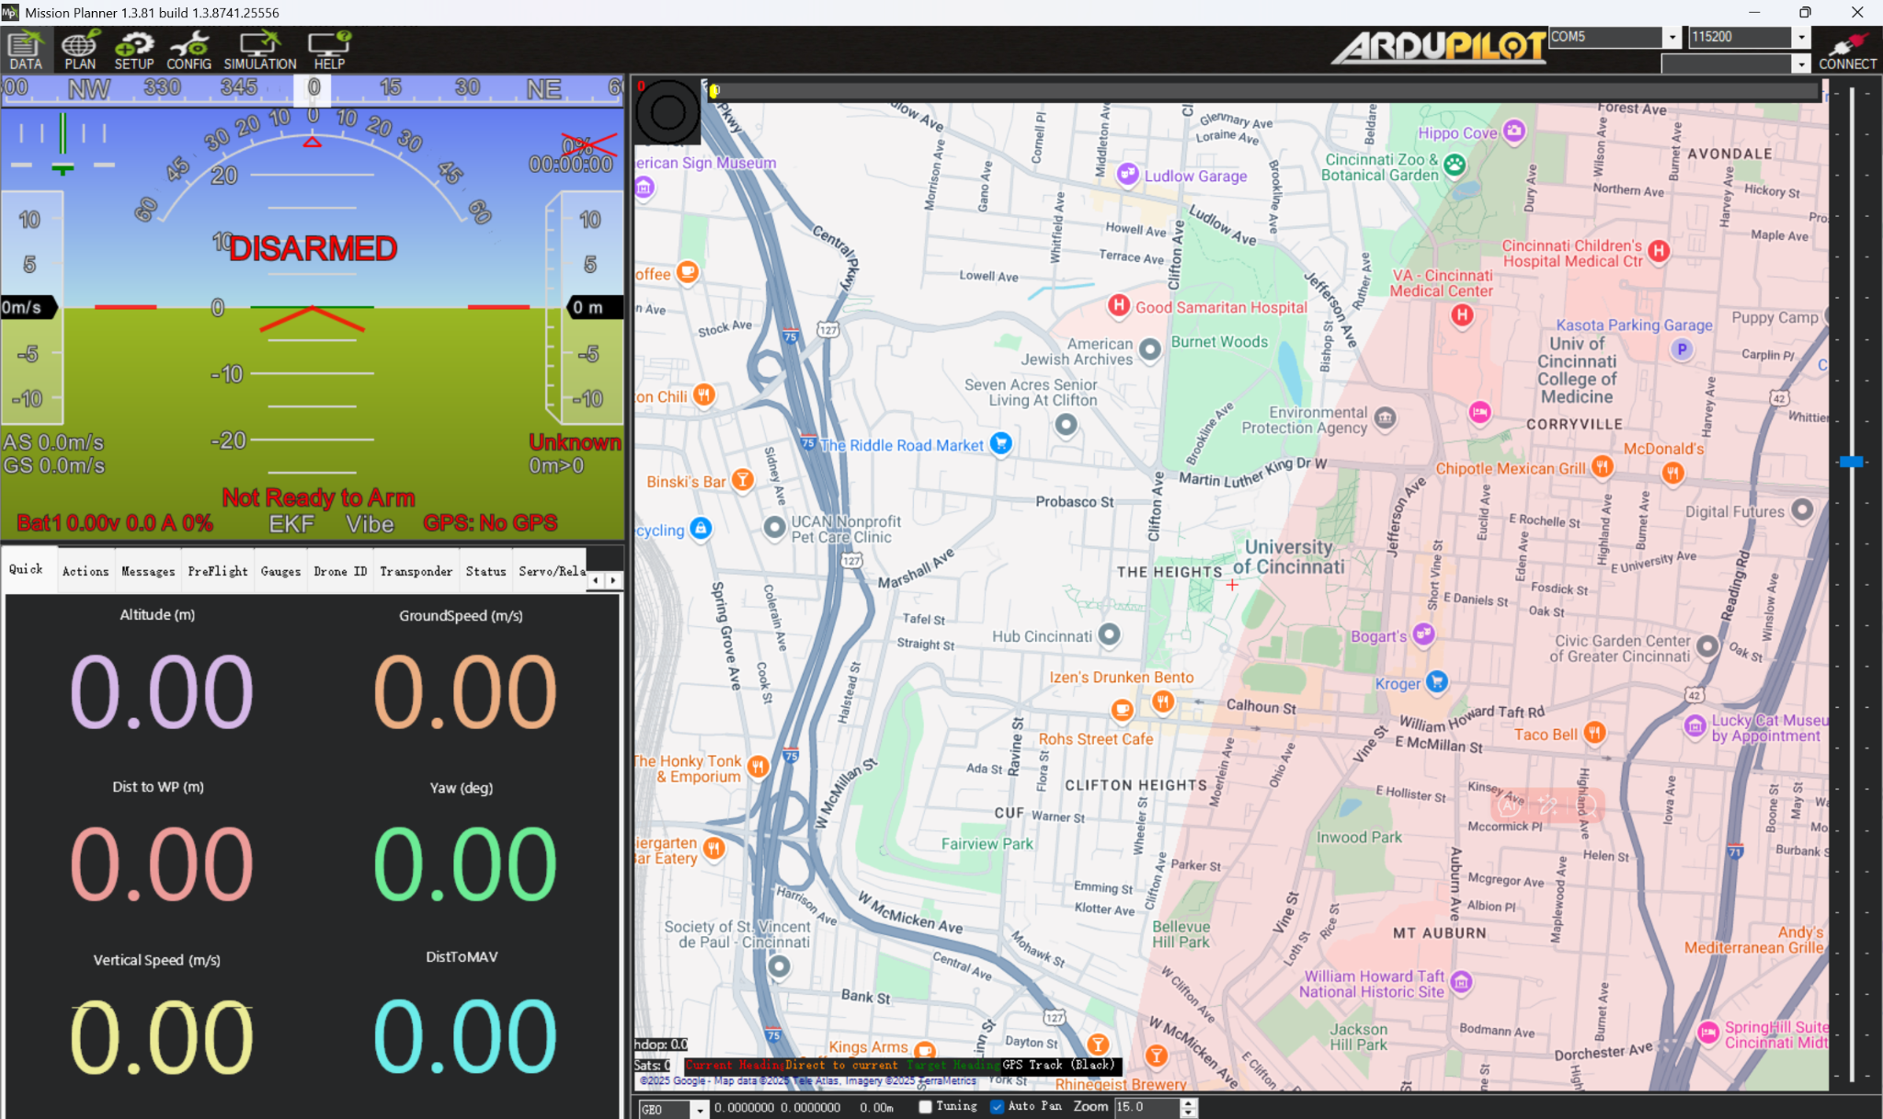
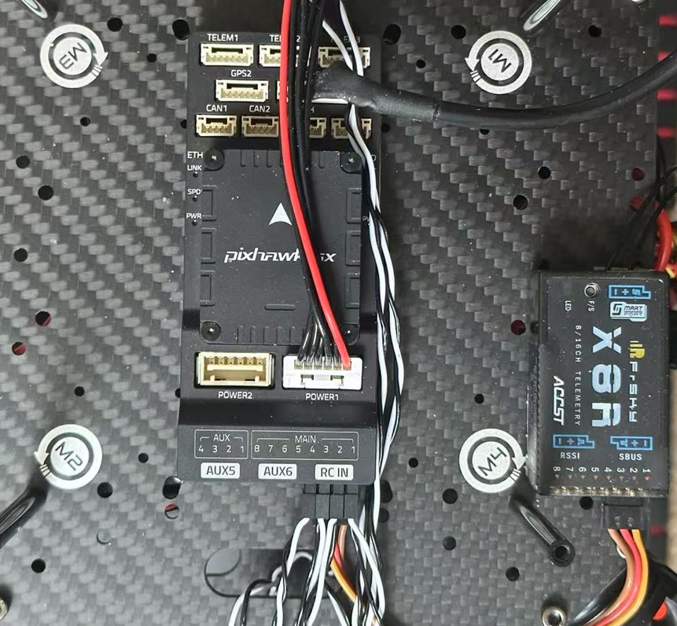
Drone Software
We selected the Pixhawk 6X flight controller and Mission Planner ground station for managing the drone's software.
Precise calibration was performed for: Accelerometer, GPS, Remote controller
Fail-safe protection was enabled to ensure safety and stability during flight.
Multiple flight modes were configured within the flight control system to accommodate various flight scenarios.

Slide 7

Design Solutions and Choices
Data Collection:
Dataset: ~3000 samples of vineyard multispectral imagery
Image Processing: open-source tools such OpenCV for image processing and pyTorch for model training
Data Preparation:
Input: aligned multispectral images (Blue, Green, Red, NIR, RedEdge).
Feature Engineering:
Compute vegetation indices (NDVI and NDRE) from the Red, NIR, and RedEdge bands.
Combine these indices with the original 5 bands to form a 7‐channel image.
Example of how a CNN works

Slide 8
Design Solutions and Choices
Model Architecture & Training:
Network: A modified ResNet‐18 adapted to accept 7‐channel inputs
Sequential pipeline:
Vine Detection Model: Classifies tiles as vine or non‐vine.
Disease Classifier: Operates on vine-positive tiles to classify them as diseased vs. healthy.
Evaluation and visualization:
Grad‐CAM is applied to the disease classifier to generate heat maps that highlight disease relevant regions.
Bounding boxes are automatically extracted from the CAM output and applied to an rgb composite image

Slide 9
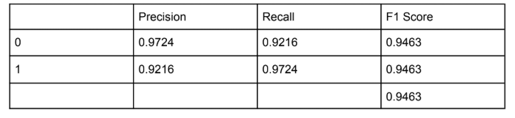
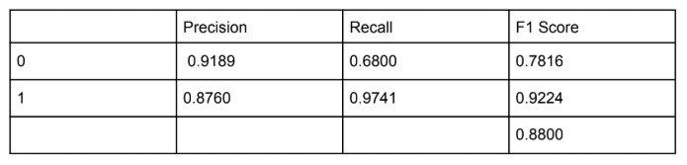
Accuracy of 83.2% for the entire pipeline

Slide 10
Design Solutions and Choices
Monitoring and Reporting:
After the drone completes its flight or round of the fields, it will upload the data to a cloud server for further analysis and report generation.
A user interface (UI) will then display the pest and disease distribution across the farmland, highlighting areas that require attention on a web/ mobile app.
Development and Testing:
Prototype Development: We started by building the prototype camera assembly to test its functionality and start to test it on the trained data.
Field Testing: We will then conduct field trials to evaluate pest detection accuracy and in real agricultural environments. Finally we will find another companies drone to put our assembly on to test it all together.

Slide 11
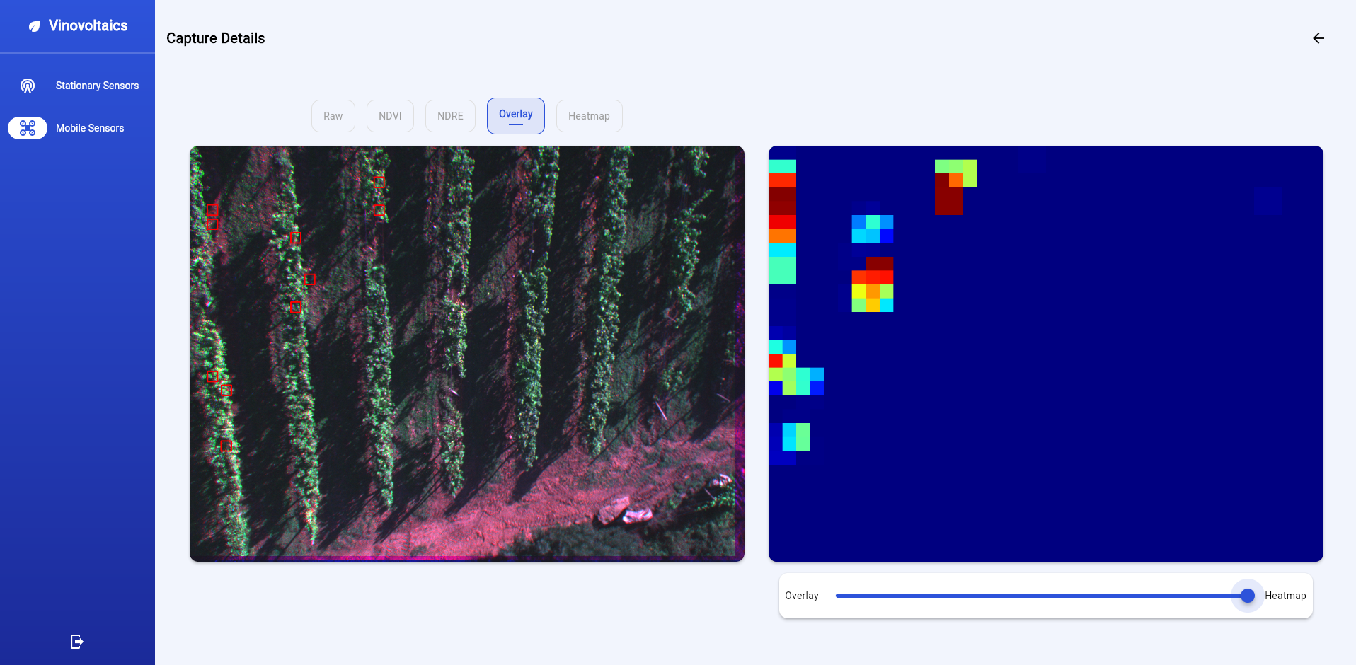

Slide 12
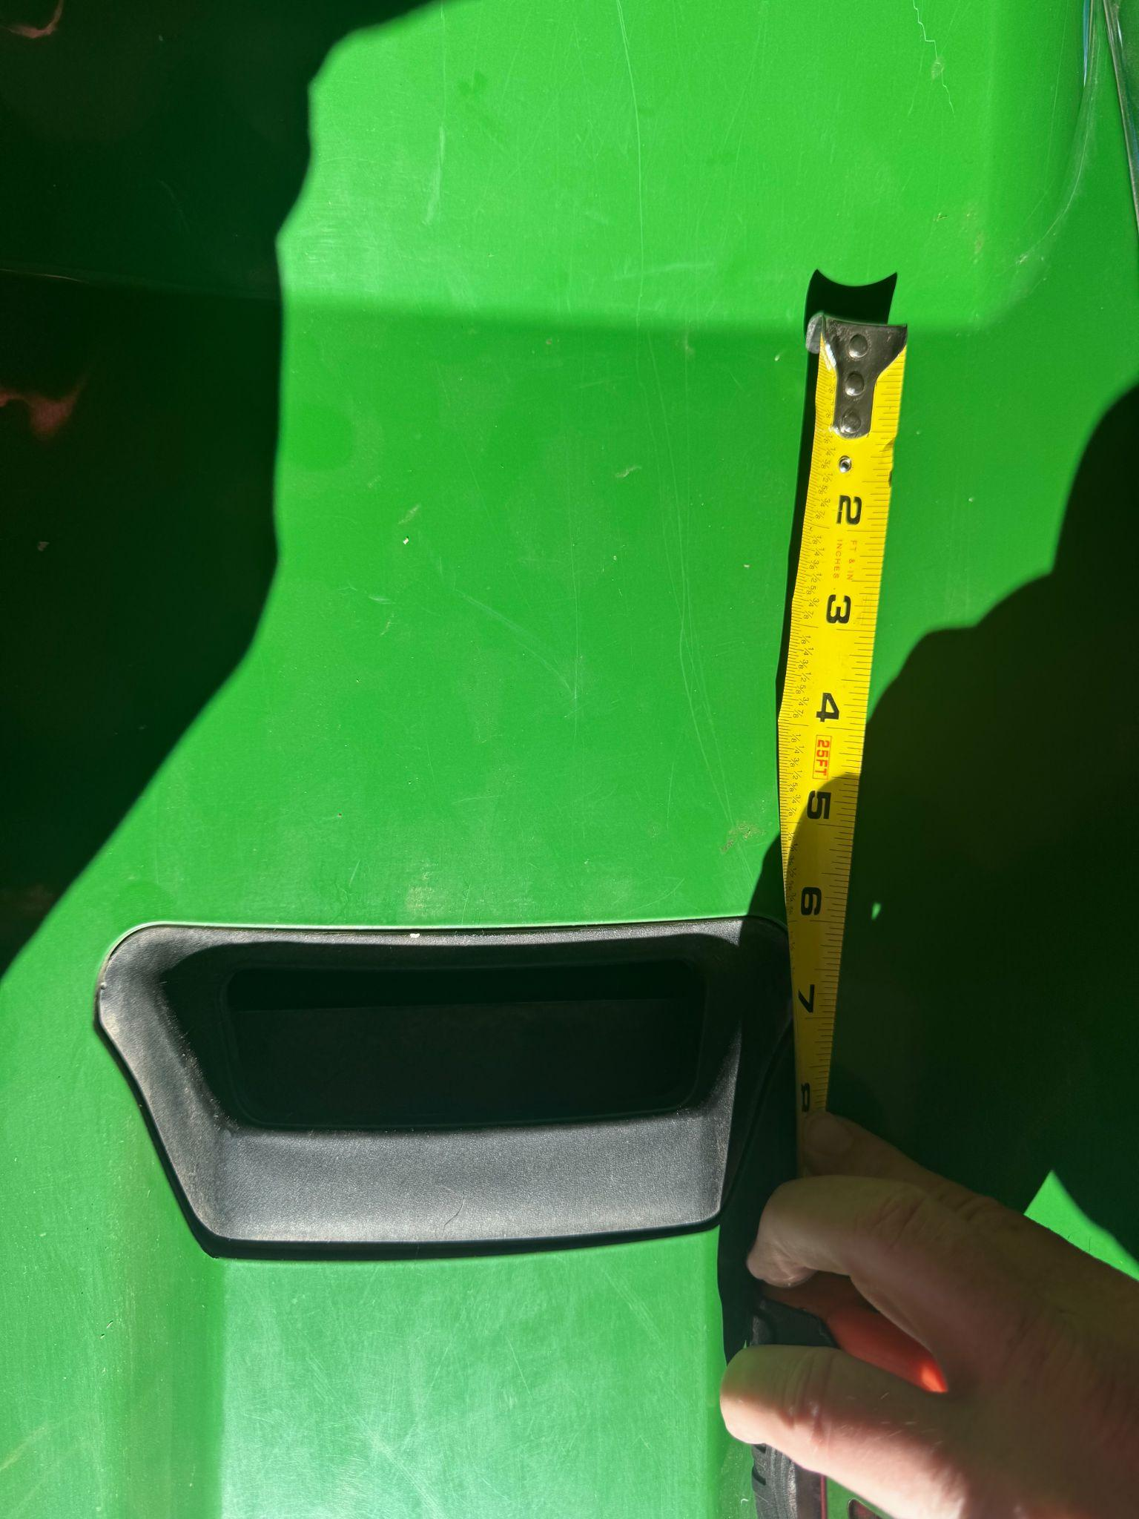
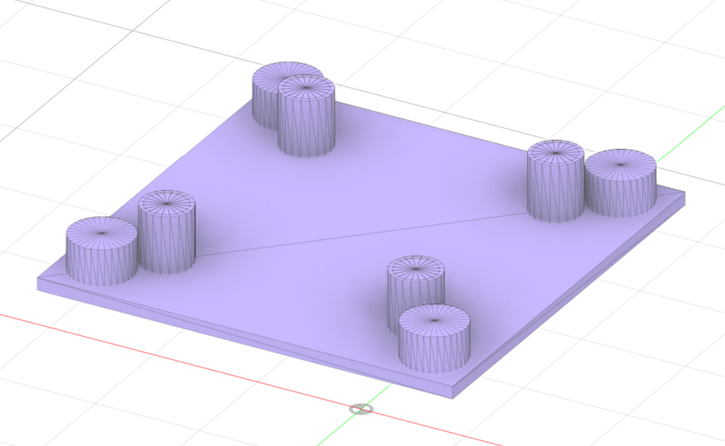
Vibration System
To connect our camera on a tractor in the field, we designed a vibration system. We plan to assemble it on the front cover of the tractor.
Four shock mounts and four spring-damper system to form the vibration system.
Base plate and tractor connect with a shock mount in each corner.
The base plate and the camera box connect with a spring-damper system.
Vibration is reduced when getting data on the tractor.

Slide 13
Design Standards
To complete our project we abided by a set of standards as a group:
Budget:
As a group we had a set budget for our total expenditures and had to make sure that all of our purchases were necessary and an efficient use of money.
Information:
All progress and information attained was shared at weekly group meetings to ensure a collaborative and effective effort towards our final goal.
Shared information was reviewed by group members to ensure that there were no better alternatives.
Regulatory:
Abided by all FAA regulations on airspace and drone safety
Abided by all UC regulations as to what we could and couldn’t purchase.
Materials:
All materials that were purchased were researched by multiple group members and checked with expert sources or university resources to ensure quality and low cost options are being found.

Slide 14
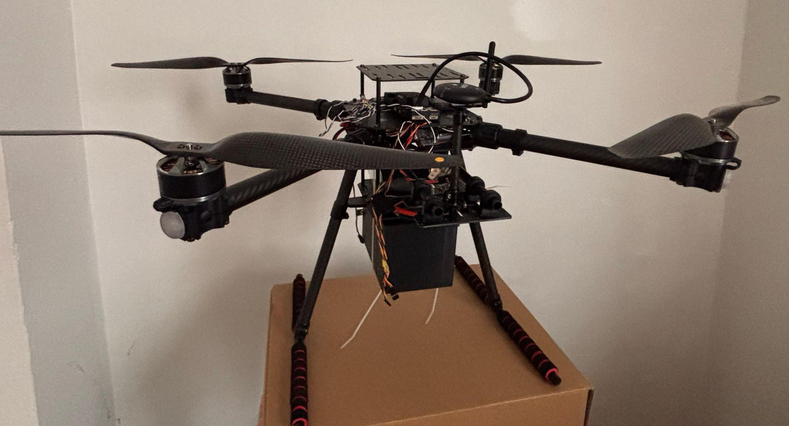
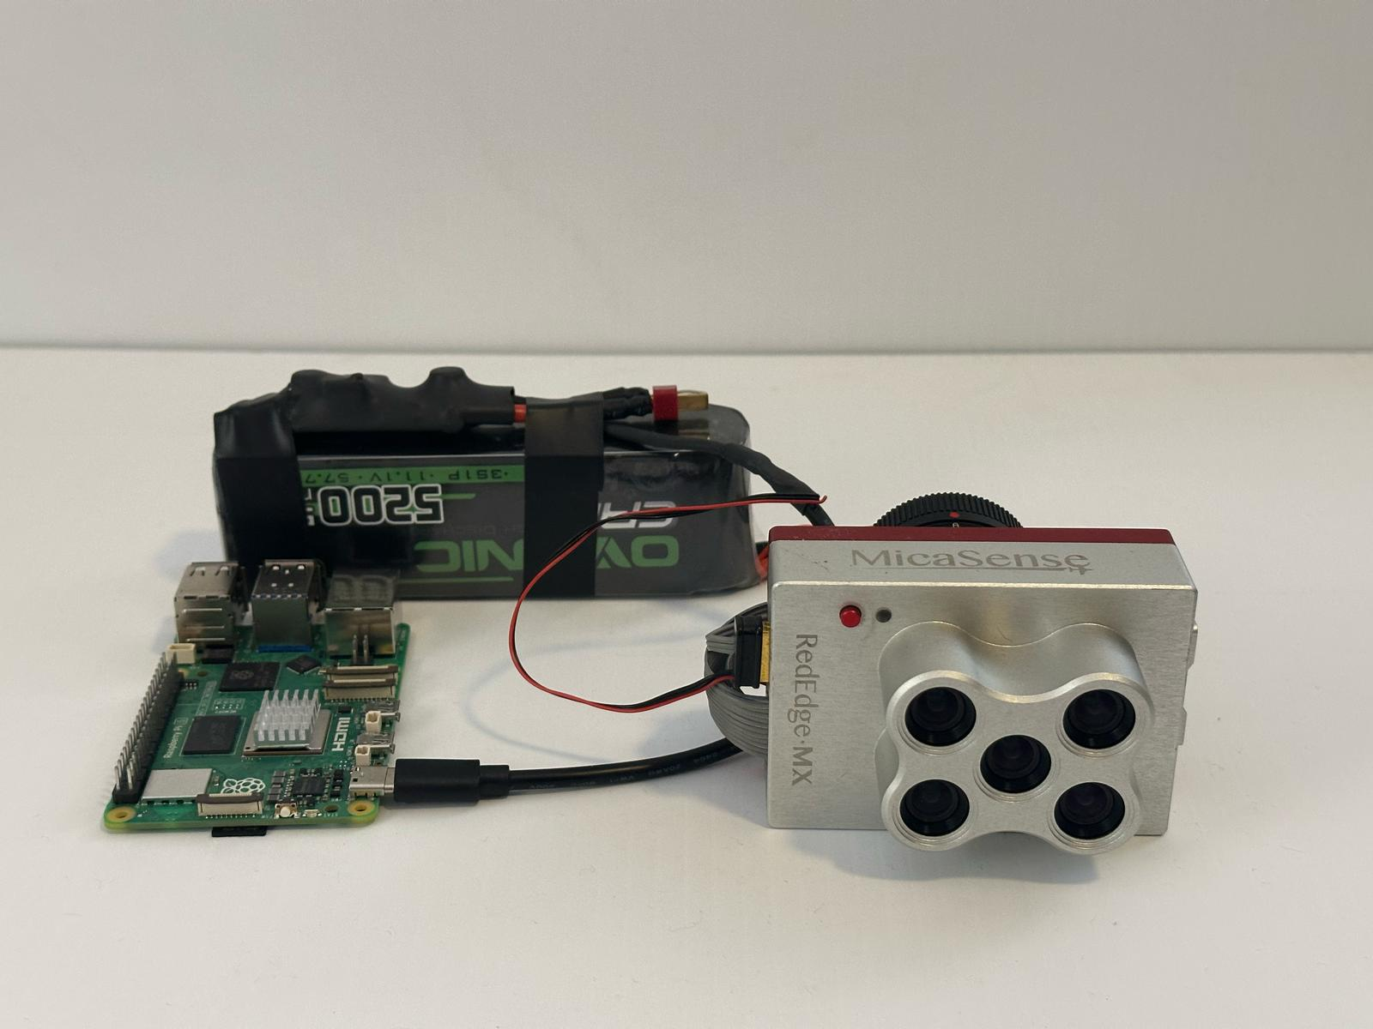
Budget & Materials
Project Budget Breakdown
OMID-USA Contribution: $6000
Equipment Cost: ~$5000
Budget Breakdown:
Drone ~$900
Camera ~$3000
Battery ~$30
Raspberry Pi 5 8GB ~ $80
Cables ~$15
Cloud computing ~$50
Drone License ~$175
Enclosure 3D printed

Slide 15
Progress/Demo
We have acquired all materials needed and assembled all components.
Our AI model is trained and is showing a high degree of accuracy for identifying plants, pests, and disease.
We have designed our camera enclosure.
We have created a vibration dampening system to mount or camera assembly to tractors or other such hardware.
We have built all the drone's hardware and configured its flight controller. We have set up fail-safe protection.
We are working diligently to try to get some flight tests as well as get some fresh data from the vineyard to further test our model as well as our drone.

Slide 16
Future Plans and Challenges
Future plans
Documented, replicable, and free
Making it even more accessible to those who benefit most
Challenges
Regulatory:
Complex airspace regulations vary by country
Strict regulations for autonomous drones in the U.S.
Accessibility and Affordability:
Ensuring target users can access and afford off the shelf parts
Addressing supply chain and cost barriers for widespread adoption

